Slide 1

Functional
Testing

Slide 2
Software Testing
Cause Effect Graphing Technique
considers the combinations of various inputs.
Two new terms are used here and these are causes and effects, which are nothing but inputs and outputs respectively
Steps
Causes & effects in the specifications are identified.
A cause is a distinct input condition or an equivalence class of input conditions.
An effect is an output condition or a system transformation.
The semantic content of the specification is analysed and transformed into a boolean graph linking the causes & effects.
Constraints are imposed
graph – limited entry decision table
Each column in the table represent a test case.
The columns in the decision table are converted into test cases.

Slide 3
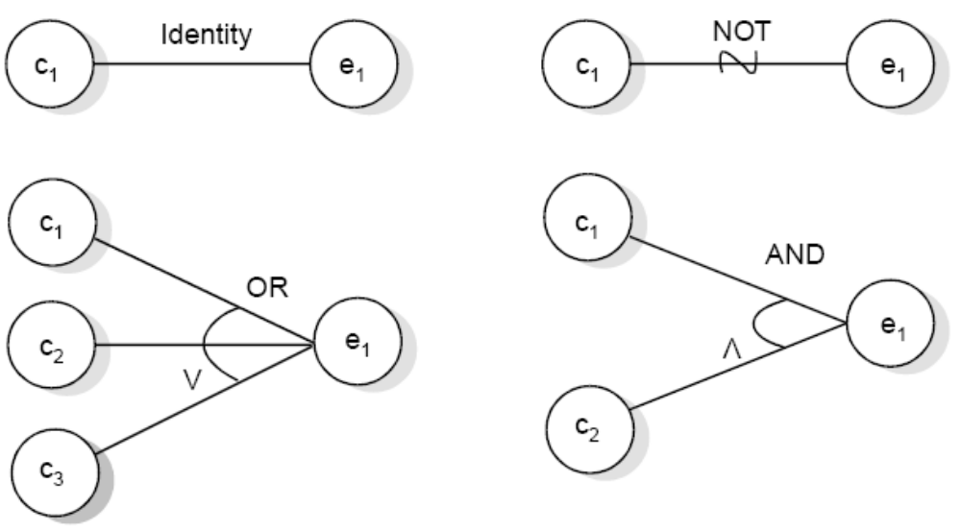
Software Testing
The basic notation for the graph is shown as:
Basic cause effect graph symbols

Slide 4
Software Testing
Example :
“The characters in column 1 must be an A or B. The character in column 2 must be a digit. In this situation, the file update is made. If the character in column 1 is incorrect, message x is issued. If the character in column 2 is not a digit, message y is issued”.
The causes are
c₁: character in column 1 is A
c₂: character in column 1 is B
c₃: character in column 2 is a digit
and the effects are
e₁: update made
e₂: message x is issued
e₃: message y is issued

Slide 5
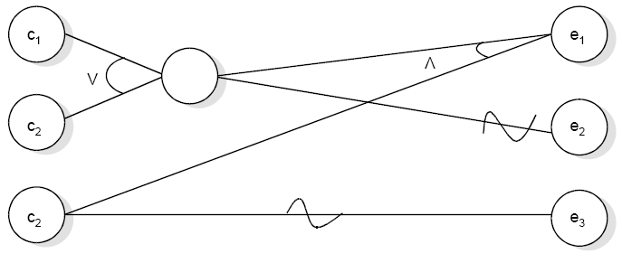
Software Testing
c₃
Sample cause effect graph

Slide 6
Software Testing
The Exclusive(E) constraint states that at most one of c₁ or c₂ can be 1 (c₁ or c₂ cannot be 1 simultaneously). However, both c1 and c2 can be 0 simultaneously.
The Inclusive constraint states that at least one of c₁ and c₂ must always be 1 (c₁ and c₂ cannot be 0 simultaneously). However, both can be 1.
The One and Only One (O) constraint states that one, and only one, of c₁ and c₂ must be 1.
The constraint Requires (R) states that, for c₁ to be 1, c₂ must be 1 (i.e. it is impossible for c₁ to be 1 if c₂ is 0),
Mask
This constraint is applicable at the effect side of the cause-effect graph. This states that if effect e1 is 1, effect e2 is forced to be 0.

Slide 7
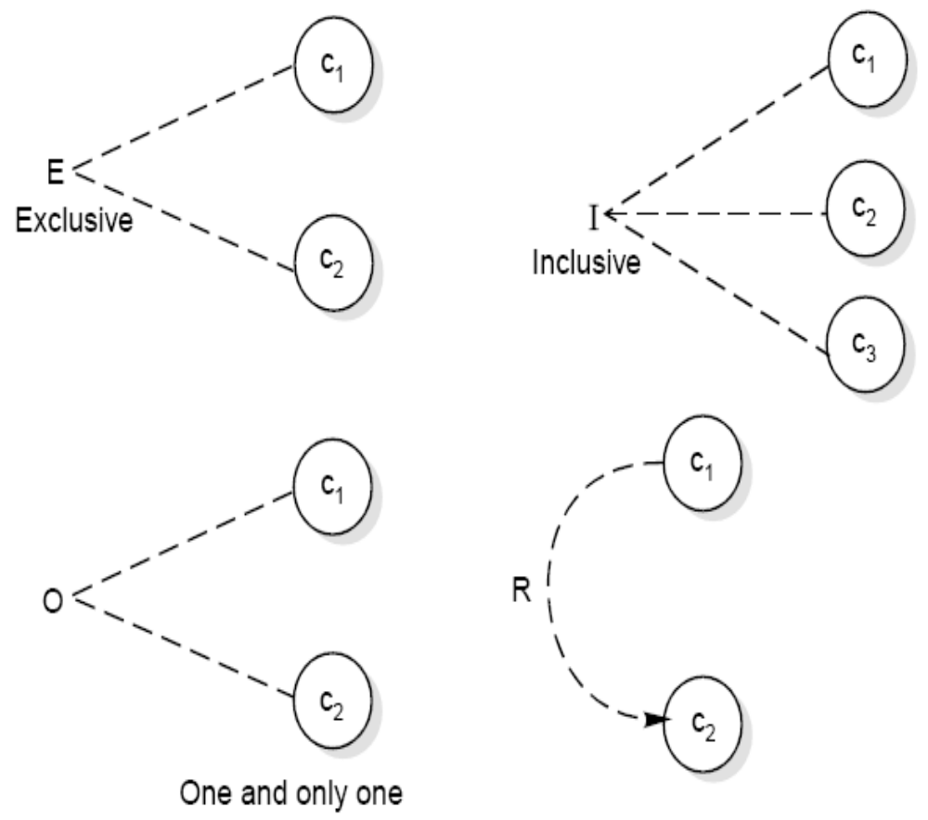
Software Testing
Constraint symbols

Slide 8
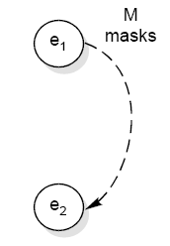
Software Testing
Symbol for masks constraint

Slide 9
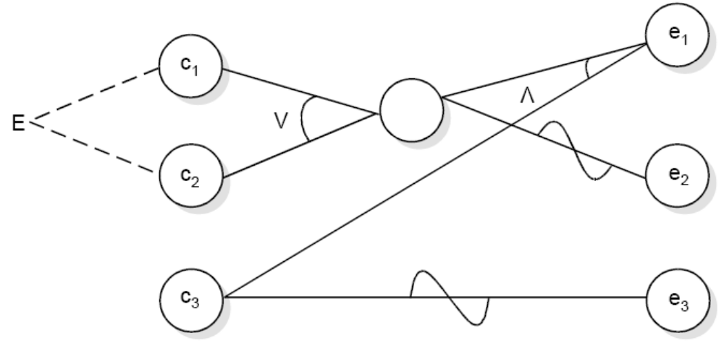
Software Testing
Fig. : Sample cause effect graph with exclusive constraint

Slide 10
Software Testing
Example
A tourist of age greater than 21 years and having a clean driving record is supplied a rental car. A premium amount is also charged if the tourist is on business otherwise it is not charged.
If the tourist is less than 21 year old, or does not have a clean driving record the system will display the following message:
“Car cannot be supplied”
Draw the Cause effect graph and identify the test cases.

Slide 11
Software Testing
Solution
The causes are
c1: Age is over 21
c2: Driving record is clean
c3: Tourist is on business
and effects are
e1: Supply a rental car without premium charge.
e2: Supply a rental car with premium charge
e3: Car cannot be supplied

Slide 12
Software Testing
c₁
e₁
c₂
e₂₂
c₃
e₃₂
Cause effect graph

Slide 13
Software Testing
Conditions | 1 | 2 | 3 | 4
c₁ : Over 21 ? | F | T | T | T
c₂ : Driving record clean ? | - | F | T | T
c₃ : On Business ? | - | - | F | T
e₁ : Supply a rental car without premium charge |  |  | T
e₂ : Supply a rental car with premium charge |  |  |  | T
e₃ : Car cannot be supplied | T | T

Slide 14
Applicability
Cause-effect graphing is a systematic method for generating test cases.
It considers dependency of inputs using some constraints.
This technique is effective only for small programs because, as the size of the program increases, the number of causes and effects also increases and thus complexity of the cause effect graph increases.
For large-sized programs, a tool may help us to design the cause-effect
graph with the minimum possible complexity.
It has very limited applications in unit testing and hardly any application in integration testing and system testing.

